Slide 1
Year Rep Training
Elgin Edison (he/him)
VP Education & Welfare, SGSU
Dr Dave Arnold (he/him) Education Strategy Manager, St George's

Slide 2
What will we cover?
What does it mean to be a Year Rep?
Signposting
Collecting feedback – being representative
Using Unitu effectively as a Year Rep
Student-Staff Committees & meeting skills
Reward & Recognition

Slide 3
1. What does it mean to be a Year Rep
Task
Go to menti.com and enter the code 6731 7123
Take 5 minutes to add your answer for each of the 5 questions

Slide 4
1. What does it mean to be a Year Rep
A) What is the purpose of a Year Rep?
To be a voice for your course, your peers
To collect feedback on course-related topics/issues
To be the channel between the University and the students
To be a role model and a leader

Slide 5
1. What does it mean to be a Year Rep
B) What will some of your tasks be?
Complete Year Rep training
To listen to students
Collect feedback on course-related topics/issues
Respond to posts on Unitu
Present feedback to staff
Attend your Student-Staff Committee
Attend SGSU Senate
Close the feedback loop!!
Signpost students to resources/support

Slide 6
1. What does it mean to be a Year Rep
C) What skills will you need or develop?
Communicating with different people in different ways
Teamwork
Problem-solving
Adaptability
Using new platforms/tools
Analytical skills
Presentation skills
Organisational skills

Slide 7
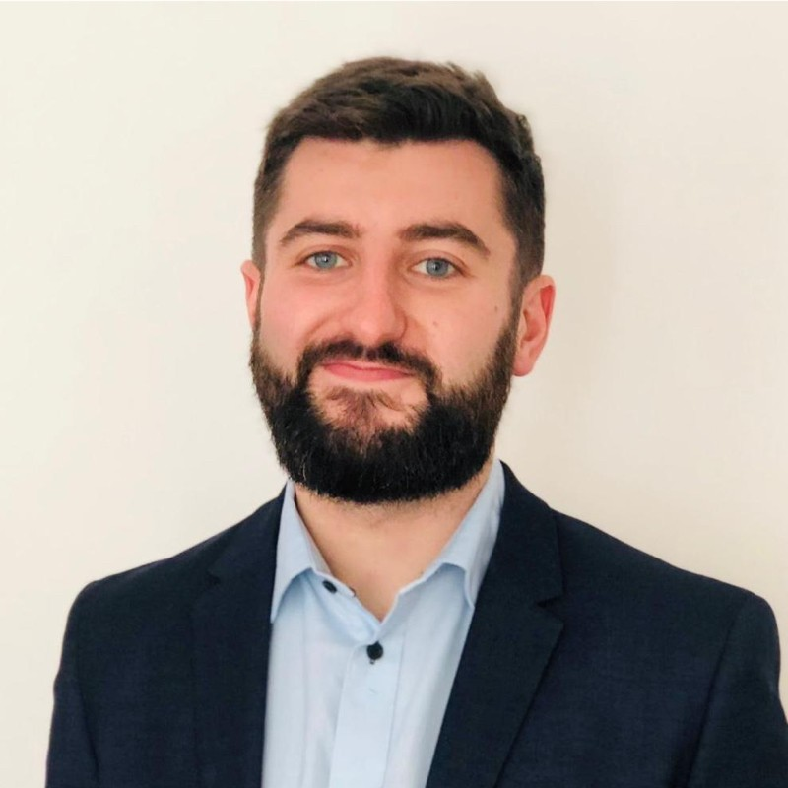
1. What does it mean to be a Year Rep
d) Who can you expect support from?
Course Director
Year Leads
SGSU
Each other!
Elgin Edison
VP Education & Welfare, SGSU
vpeducation@su.sgul.ac.uk
Dr Dave Arnold
Education Strategy Manager, St George's
darnold@sgul.ac.uk

Slide 8
1. What does it mean to be a Year Rep
e) How will being a Year Rep benefit you?
Looks good on your CV
Meet new people
Develop new skills
Get to be involved in key decisions for your course and for the University
Solve problems and make change that matters!
Get recognised with certificate

Slide 9
2. Signposting
Sometimes you won't be able to help – that's ok!
You might not know (but sometimes you can find out)
You aren't the expert in everything
Luckily, there are the right people/information out there
Help yourself by not taking on everyone's problems!

Slide 10
2. Signposting – where would you signpost these people?
A student is looking for the module handbook and can't find it...
Someone discloses to you that they are struggling with anxiety and their mental health...
A student comes up to you and says they are really struggling with the cost of their bills and transport...
A student tells you they are dyslexic and want some support...
Someone is having issues with halls accommodation...
A student is unhappy with their mark and want to appeal...

Slide 11
3. Collecting feedback
Methods to collect feedback:
Speaking to people
WhatsApp group
Poll/survey
Unitu
At the end of a lecture
Drop-in session
Scenario
A few students have been complaining to you about a 9am lecture on your timetable. You ran a quick poll...
Fine with 9am – 60%
Can do 9am or 10am – 25%
Can't do 9am – 15%
What would you propose to staff?
But how do you know if the feedback is meaningful?
How is it representative?

Slide 12
4. Using Unitu
Unitu is great for getting your voice heard
But there are ways it can be used effectively
Year Reps have a key role – it doesn't work without you!

Slide 13
4. The DOs and DON'Ts of using Unitu as a Year Rep
DO...
regularly check Unitu
comment on posts and answer questions/signpost
move posts across when they require an answer from staff, have good engagement, are representative
share links to posts with your course
ask for more details, specifics before moving across
Close posts in the private area if you can

Slide 14
4. The DOs and DON'Ts of using Unitu as a Year Rep
DON'T...
forget to check Unitu
assume someone else will deal with it
move every post across without looking
move across individual people's issues or inappropriate posts

Slide 15
5. Student-Staff Committees
St George's is introducing Student-Staff Committees for all taught courses
Student-led
It will be chaired by students
Running slightly differently on each programme – 22-23 is trial year

Slide 16
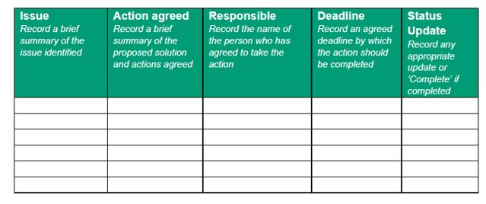
5. Student-Staff Committees – tracking actions
Student chair will lead agenda setting
You can add what you want to talk about
Course administrator and/or a skilled Year Rep will take minutes
Action Tracker to be shared on Canvas

Slide 17
5. Student-Staff Committees – meeting skills
Task
We will split into three groups
Groups should discuss what you need to do:
Group 1: Before the meeting
Group 2: During the meeting
Group 3: After the meeting

Slide 18
5. Student-Staff Committees – meeting skills
Before the meeting...
Find out where and when the meeting is
What is the link?
Collect feedback from students
Analyse and collate feedback
Give notice about items to the chair/organiser
Read any papers or documents in advance

Slide 19
5. Student-Staff Committees – meeting skills
During the meeting...
Be on time! (and send apologies if you can't be there)
Listen attentively
Be aware if you need to raise your hand
Take concise notes – or ensure there is a note-taker
Clarify actions
Be polite and modify your communication

Slide 20
5. Student-Staff Committees – meeting skills
After the meeting...
Check the notes, agree them
Circulate any updates
Complete your actions
Follow up on other actions
Close the feedback loop – tell students about your hard work
Ensure Action Trackers are available on Canvas

Slide 21
5. Student-Staff Committees
Courses will need student-chairs
There will be a short training session provided to help/support you
We will be in touch very shortly

Slide 22
6. Reward and recognition
Year Reps are incredibly important to St George's and we really value your contribution
SGSU will recognise Year Reps with a certificate
The University would like to celebrate your brilliant contributions

Slide 23
Thank you!
Thank you for your attention and valuable time.
Any questions to VPEducation@su.sgul.ac.uk
Specific Unitu questions to unitu@sgul.ac.uk

